Slide 1
Statistical Natural Language Parsing
Two views of syntactic structure

Slide 2
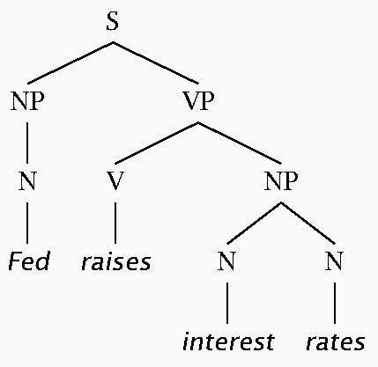
Two views of linguistic structure: 1. Constituency (phrase structure)
Phrase structure organizes words into nested constituents.
How do we know what is a constituent? (Not that linguists don’t argue about some cases.)
Distribution: a constituent behaves as a unit that can appear in different places:
John talked [to the children] [about drugs].
John talked [about drugs] [to the children].
*John talked drugs to the children about
Substitution/expansion/pro-forms:
I sat [on the box/right on top of the box/there].
Coordination, regular internal structure, no intrusion, fragments, semantics, …

Slide 3
Two views of linguistic structure: 1. Constituency (phrase structure)
Phrase structure organizes words into nested constituents.
How do we know what is a constituent? (Not that linguists don’t argue about some cases.)
Distribution: a constituent behaves as a unit that can appear in different places:
John talked [to the children] [about drugs].
John talked [about drugs] [to the children].
*John talked drugs to the children about
Substitution/expansion/pro-forms:
I sat [on the box/right on top of the box/there].
Coordination, regular internal structure, no intrusion, fragments, semantics, …
Notes:
Use Fed raises interest rates example.

Slide 4
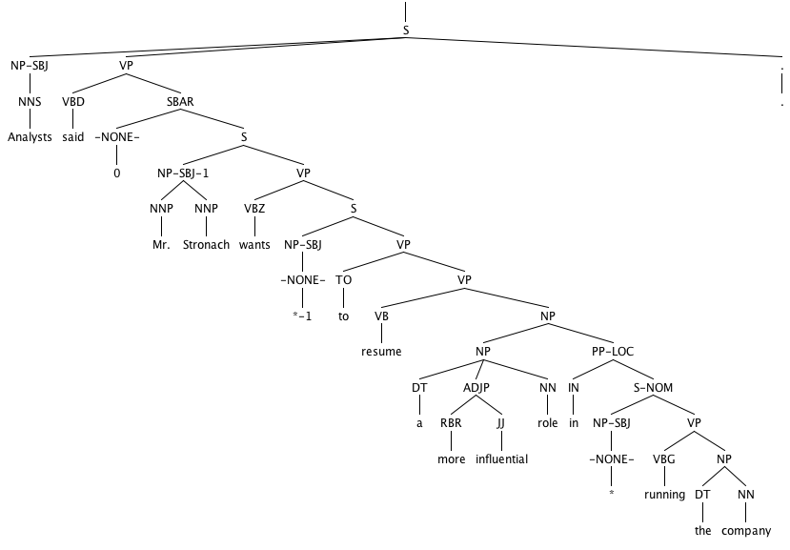

Slide 5
Headed phrase structure
VP → … VB* …
NP → … NN* …
ADJP → … JJ* …
ADVP → … RB* …
SBAR(Q) → S|SINV|SQ → … NP VP …
Plus minor phrase types:
QP (quantifier phrase in NP), CONJP (multi word constructions: as well as), INTJ (interjections), etc.

Slide 6
Two views of linguistic structure: 2. Dependency structure
Dependency structure shows which words depend on (modify or are arguments of) which other words.
put
boy
tortoise
on
The
the
rug
The
boy
put
the
tortoise
on
the
rug
the

Slide 7
Two views of linguistic structure: 2. Dependency structure
Dependency structure shows which words depend on (modify or are arguments of) which other words.
The boy put the tortoise on the rug

Slide 8
Statistical Natural Language Parsing
Two views of syntactic structure

Slide 9
Statistical Natural Language Parsing
Parsing: The rise of data and statistics

Slide 10
Pre 1990 (“Classical”) NLP Parsing
Wrote symbolic grammar (CFG or often richer) and lexicon
S → NP VP NN → interest
NP → (DT) NN NNS → rates
NP → NN NNS NNS → raises
NP → NNP VBP → interest
VP → V NP VBZ → rates
Used grammar/proof systems to prove parses from words
This scaled very badly and didn’t give coverage. For sentence:
Fed raises interest rates 0.5% in effort to control inflation
Minimal grammar: 36 parses
Simple 10 rule grammar: 592 parses
Real-size broad-coverage grammar: millions of parses

Slide 11
Classical NLP Parsing: The problem and its solution
Categorical constraints can be added to grammars to limit unlikely/weird parses for sentences
But the attempt make the grammars not robust
In traditional systems, commonly 30% of sentences in even an edited text would have no parse.
A less constrained grammar can parse more sentences
But simple sentences end up with ever more parses with no way to choose between them
We need mechanisms that allow us to find the most likely parse(s) for a sentence
Statistical parsing lets us work with very loose grammars that admit millions of parses for sentences but still quickly find the best parse(s)

Slide 12
The rise of annotated data: The Penn Treebank
[Marcus et al. 1993, Computational Linguistics]
( (S
(NP-SBJ (DT The) (NN move))
(VP (VBD followed)
(NP
(NP (DT a) (NN round))
(PP (IN of)
(NP
(NP (JJ similar) (NNS increases))
(PP (IN by)
(NP (JJ other) (NNS lenders)))
(PP (IN against)
(NP (NNP Arizona) (JJ real) (NN estate) (NNS loans))))))
(, ,)
(S-ADV
(NP-SBJ (-NONE- *))
(VP (VBG reflecting)
(NP
(NP (DT a) (VBG continuing) (NN decline))
(PP-LOC (IN in)
(NP (DT that) (NN market)))))))
(. .)))

Slide 13
The rise of annotated data
Starting off, building a treebank seems a lot slower and less useful than building a grammar
But a treebank gives us many things
Reusability of the labor
Many parsers, POS taggers, etc.
Valuable resource for linguistics
Broad coverage
Frequencies and distributional information
A way to evaluate systems

Slide 14
Statistical parsing applications
Statistical parsers are now robust and widely used in larger NLP applications:
High precision question answering [Pasca and Harabagiu SIGIR 2001]
Improving biological named entity finding [Finkel et al. JNLPBA 2004]
Syntactically based sentence compression [Lin and Wilbur 2007]
Extracting opinions about products [Bloom et al. NAACL 2007]
Improved interaction in computer games [Gorniak and Roy 2005]
Helping linguists find data [Resnik et al. BLS 2005]
Source sentence analysis for machine translation [Xu et al. 2009]
Relation extraction systems [Fundel et al. Bioinformatics 2006]

Slide 15
Statistical Natural Language Parsing
Parsing: The rise of data and statistics

Slide 16
Statistical Natural Language Parsing
An exponential number of attachments

Slide 17
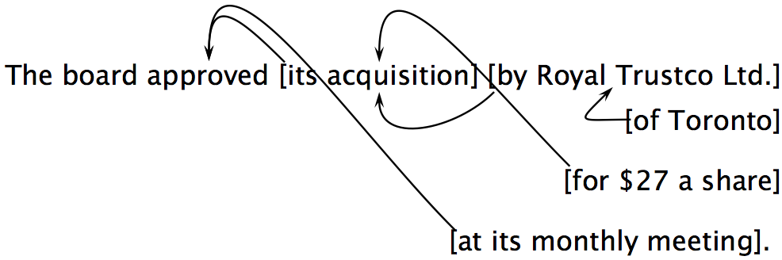
Attachment ambiguities
A key parsing decision is how we ‘attach’ various constituents
PPs, adverbial or participial phrases, infinitives, coordinations, etc.
Catalan numbers: C_{n} = (2n)!/[(n+1)!n!]
An exponentially growing series, which arises in many tree-like contexts:
E.g., the number of possible triangulations of a polygon with n+2 sides
Turns up in triangulation of probabilistic graphical models….
Notes:
No constraints, just exponential 2^n
But normally assuming nesting: at its monthly meeting could modify “for $27 a share or “its acquisition” or “aproved”, but not “by Roay Trustco Ltd.” or “of Toronto

Slide 18
Attachment ambiguities
A key parsing decision is how we ‘attach’ various constituents
PPs, adverbial or participial phrases, infinitives, coordinations, etc.
Catalan numbers: C_{n} = (2n)!/[(n+1)!n!]
An exponentially growing series, which arises in many tree-like contexts:
E.g., the number of possible triangulations of a polygon with n+2 sides
Turns up in triangulation of probabilistic graphical models….
Notes:
No constraints, just exponential 2^n
But normally assuming nesting: at its monthly meeting could modify “for $27 a share or “its acquisition” or “aproved”, but not “by Roay Trustco Ltd.” or “of Toronto

Slide 19
Quiz Question!
How many distinct parses does the following sentence have due to PP attachment ambiguities?
A PP can attach to any preceding V or N within the verb phrase, subject only to the parse still being a tree.
(This is equivalent to there being no crossing dependencies, where if d₂ is a dependent of d₁ and d₃ is a dependent of d₂, then the line d₂–d₃ begins at d₂ under the line from d₁ to d₂.)
John wrote the book with a pen in the room.

Slide 20
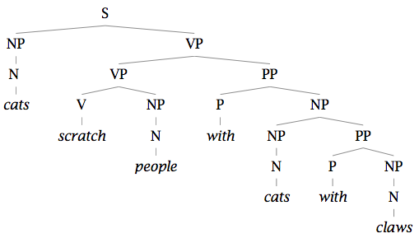
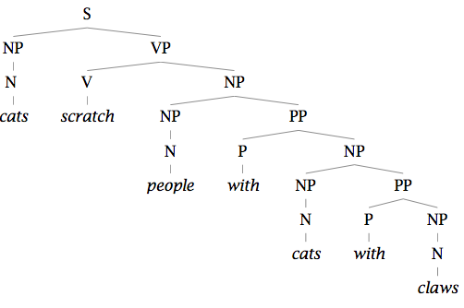
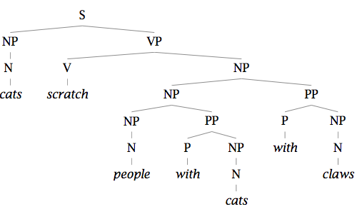
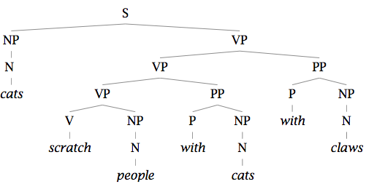
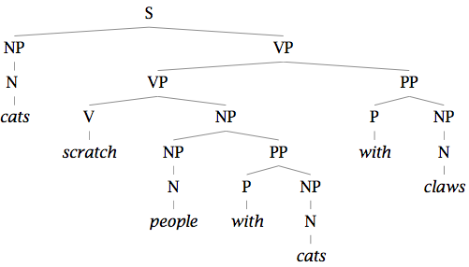
Two problems to solve: 1. Repeated work…

Slide 21
Two problems to solve: 1. Repeated work…

Slide 22
Two problems to solve: 2. Choosing the correct parse
How do we work out the correct attachment:
She saw the man with a telescope
Is the problem ‘AI complete’? Yes, but …
Words are good predictors of attachment
Even absent full understanding
Moscow sent more than 100,000 soldiers into Afghanistan …
Sydney Water breached an agreement with NSW Health …
Our statistical parsers will try to exploit such statistics.

Slide 23
Statistical Natural Language Parsing
An exponential number of attachments

